Slide 1


Advance Your Advocacy Practice: Understanding gender-based violence and disability through an intersectional lens

Slide 2
Understanding Gender-Based Violence and Disability through an Intersectional Lens Amy Turton, Gender & Disability Program Coordinator Wednesday 13 May 2026

Slide 3

Notes:
WDV respectfully acknowledges the Traditional Owners of the lands on which we work, across so-called Victoria, and pay our respects to their Elders past and present. WDV acknowledges that sovereignty has never been ceded, and supports reconciliation, justice and the recognition of the ongoing living culture of all Aboriginal and Torres Strait Islander people.

Slide 4

Notes:
Please note, we will be discussing violence and discrimination against women and gender diverse people with disabilities. These topics can be distressing for some participants.
Please take care of yourself during the session – feel free to turn your camera off or take a break as needed.
If you would like to speak to someone about how you are feeling or your own experiences of violence, you can contact 1800 Respect on 1800 737 732. This service is also available for third party debrief if you are a worker experiencing vicarious trauma.
WDV’s referral directory includes a list of additional services, including support for LGBTIQA+ and Aboriginal and Torres Strait Islander communities. https://wdv.org.au/resources/support-service-referral-options/

Slide 5
What is Gender-Based Violence?
Any act of violence directed at someone because of their gender.
Because of gender inequalities, it disproportionately affects women, girls, and gender diverse people.
Gender-based violence can cause physical, sexual, financial and psychological harm.
It also includes threats of violence, coercion and manipulation.
Can occur in public or in private.
Some forms of gender-based violence include:
Domestic violence: Violence perpetrated by a current or previous partner.
Family violence: A broader term that includes violence between family members, and family-like members. This can include domestic violence but also harm perpetrated within other relationships like parent-child, housemates, sibling, extended family, or carers.
Notes:
Women and gender diverse people with disabilities experience violence:​
- more frequently ​
- over a longer period of time​
- across a wider range of settings​
perpetrated by a greater range of people

Slide 6
What is Primary Prevention?
Ongoing process that enables victim-survivors to find safety, health, wellbeing, resilience and to thrive in all areas of their life.
Recovery
Response
Support victim-survivors and holds perpetrators to account, aiming to prevent the reoccurrence of violence.
(or tertiary prevention)
Early intervention
Aims to change the trajectory for individuals at higher-than-average risk of perpetrating or experiencing violence.
(or secondary prevention)
Gender & Disability Workforce Development Program
Whole-of-population initiatives that address the primary (‘first’ or ‘underlying’) drivers of violence against women.
Primary prevention
Source: Our Watch et al 2015 – Change the Story framework for primary prevention of violence against women and their children Australia
Notes:
WDV’s Gender and Disability Workforce Development Program focuses on the primary prevention of violence against women and gender diverse people with disabilities.
Primary prevention takes action to address the attitudes, systems and structures that lead to gender-based violence and aims to stop the harm before it occurs. It is one of the four domains of activity to respond to, reduce, and ultimately end gendered based violence.
The other domains are:
Intervention focuses on taking action when the early signs of violence appear.
Response deal with what to do after violence has already happened.
Recovery engages victim-survivors of violence in healing beyond the initial response.

Slide 7
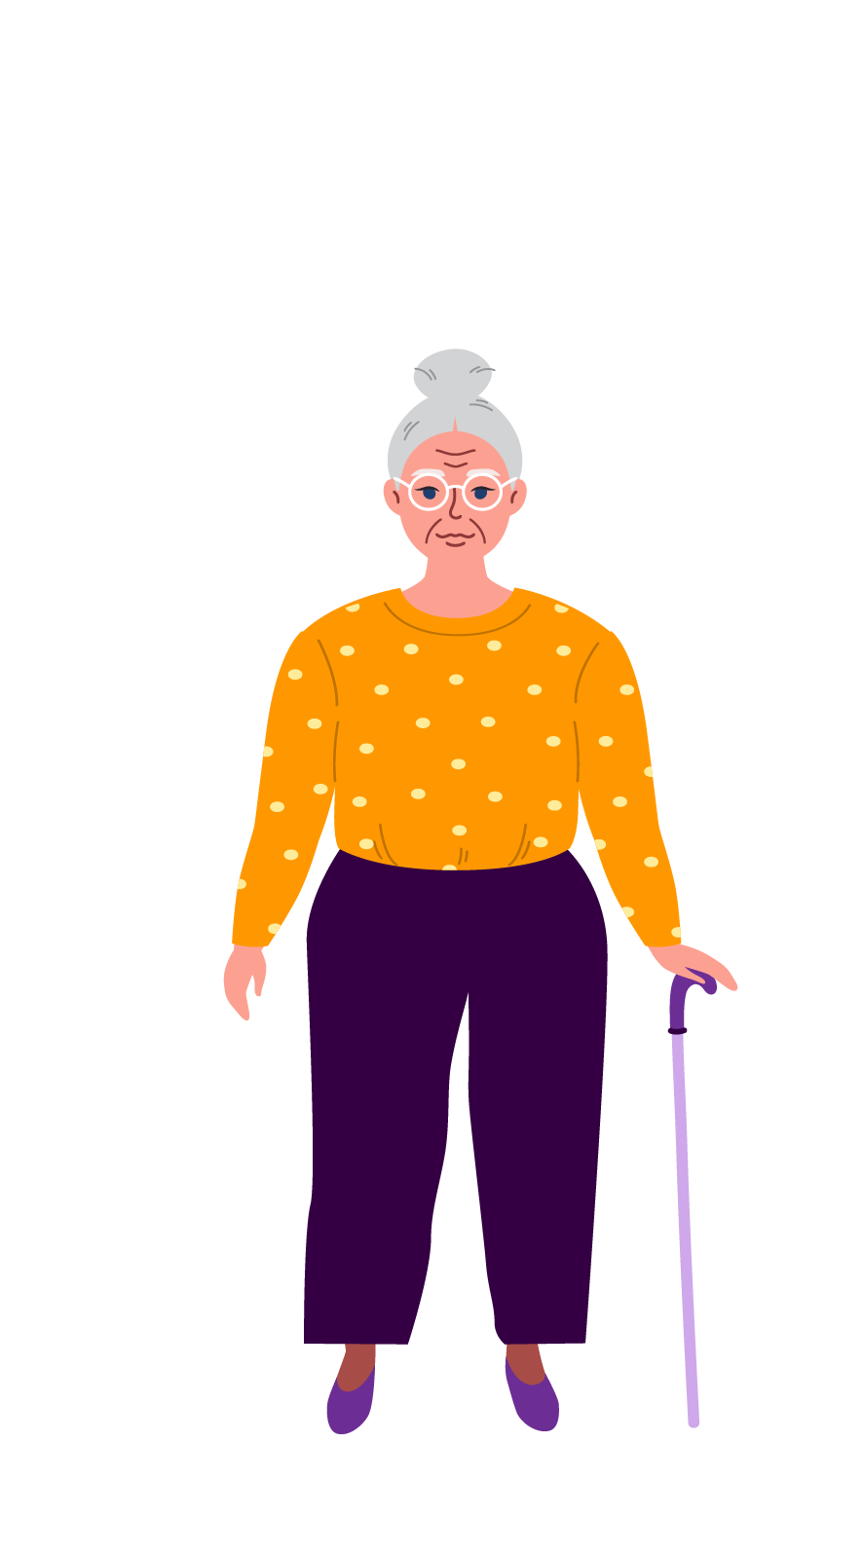
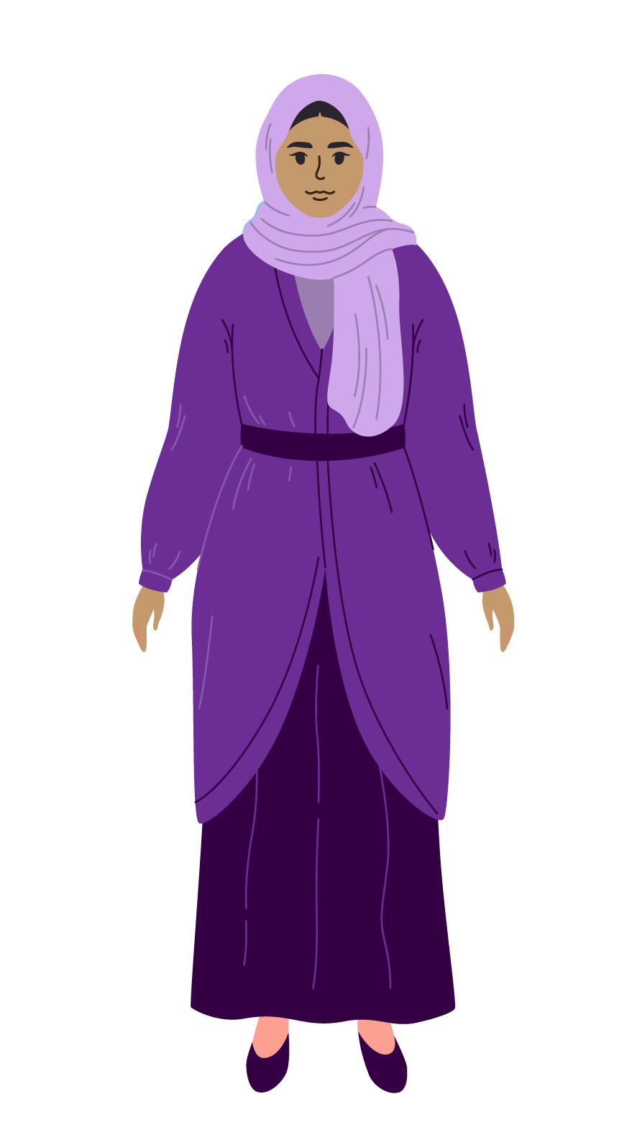
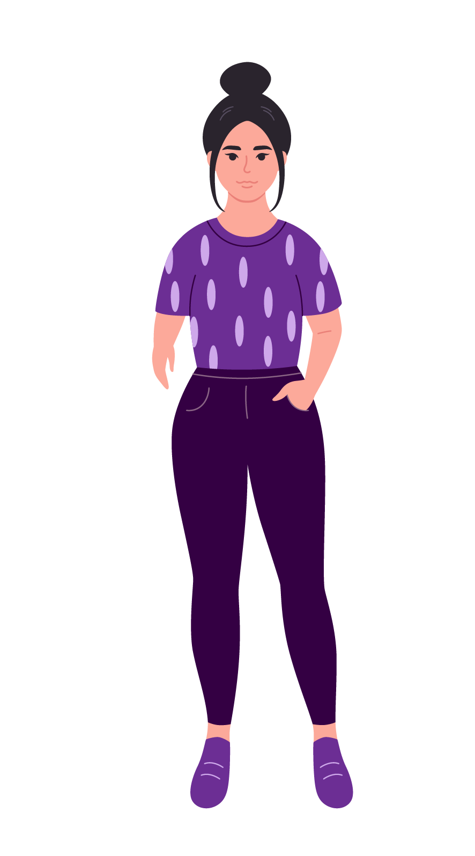
What is Intersectionality?
Originally coined by Kimberlé Crenshaw in 1989, intersectionality considers how overlapping forms of structural or systemic oppression and privilege shape our experiences.
Factors such as sexism, ableism, racism, colonialism, ageism, homophobia, and transphobia intersect to drive discrimination experienced by individuals and groups.
Notes:
Kimberlé Crenshaw coined intersectionality in 1989 to explain how the combined impacts of racism and sexism create unique experiences of discrimination for African-American women.
An intersectional understanding of disability recognises that people’s experiences of disability are shaped by their identities, relationships, and social factors. They may experience discrimination and disadvantage based on race, class, nationality, sexuality, gender, religion, age, body shape, or health status, as well as disability.
Adopting an intersectional lens recognises that amongst people with disabilities, other social hierarchies are reflected. For example, Australian citizens and permanent residents may be eligible for the NDIS or DSP, while temporary visa holders are not. As a result, they will have different experiences of disability.​

Slide 8
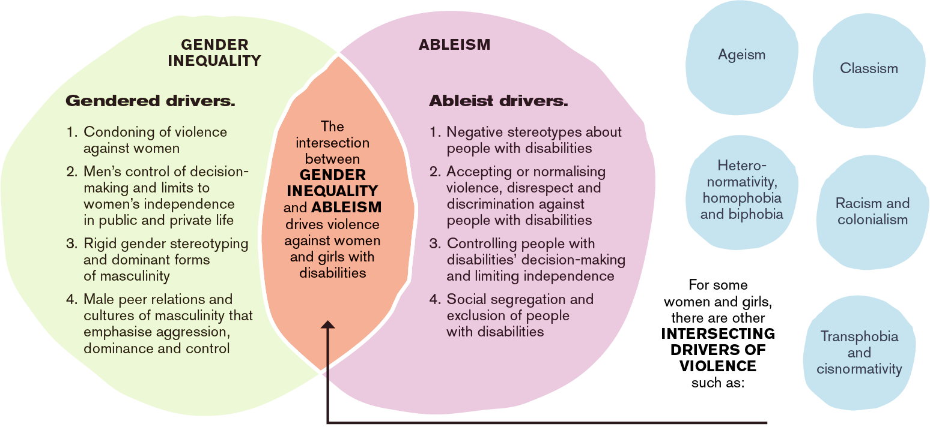
Intersecting Drivers of Violence
Against Women with Disabilities
Source: Our Watch, WDV, 2022, Changing the Landscape
Notes:
This image is the conceptual model from Changing the Landscape: A National Resource to Prevent Violence Against Women and Girls with Disabilities, published by Our Watch and WDV in 2022
It identifies gendered and ableist drivers and how they intersect to drive higher rates of violence against women and gender diverse people with disabilities.
Gendered drivers:
Condoning of violence against women.
Men’s control of decision-making and limits to women’s independence in public and private life.
Rigid gender stereotyping and dominant forms of masculinity.
Male peer relations and cultures of masculinity that emphasise aggression, dominance and control.
Ableist drivers: (Provide 1 example for each.)
Negative stereotypes about people with disabilities.
Accepting or normalising violence, disrespect and discrimination against people with disabilities.
Controlling people with disabilities decision-making and limiting independence.
Social segregation and exclusion of people with disabilities.
The intersection between gender inequality and ableism drives violence against women with disabilities.
For some women and gender diverse people, there are other intersecting drivers of violence, including but not limited to:
Ageism
Classism
Racism and colonialism
Hetero-normativity, homophobia and biphobia
Transphobia and cisnormativity

Slide 9
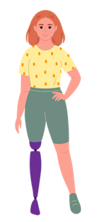
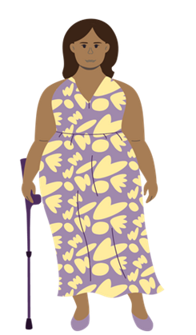
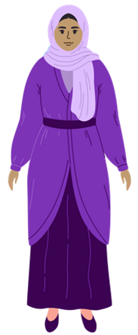
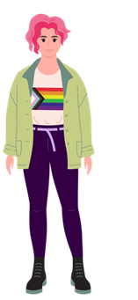
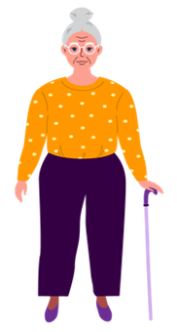
Intersectional Experiences of Violence
Women with disabilities from non-English speaking backgrounds are more likely than those from English speaking backgrounds to have experienced domestic, physical or sexual violence, and coercive control.
Over half of young women who report violence have a disability, and experience discrimination when seeking support or advice.
The prevalence of disability is greater for First Nations people; almost 1 in 4 or 24% have disabilities.
First Nations women are 34 times more likely than non-First Nations women to be hospitalised due to family and domestic violence.
52% women aged 65 and over have some form of disability, increasing to 80% aged 85 and over.
1 in 3 LGBTIQA+ people with disabilities aged 14–21 experienced sexual harassment or assault in the previous 12 months due to their sexual orientation or gender identity.
Women with disabilities in a rural setting experience a higher risk of social isolation and have less access to support services.
Older women with disabilities report higher rates of physical violence, sexual violence, intimate partner violence, emotional abuse and/or stalking compared to older women without disabilities.
Source: WDV, 2025, ‘Facts on Violence’
Notes:
Some women and gender diverse people with disabilities experience even higher rates of violence and discrimination.​
​​
An intersectional approach acknowledges that gender inequality and ableism may be compounded by other forms of disadvantage that a person may experience due to other characteristics, such as:​
Race​
Aboriginality​
Religion​
Ethnicity​
Age​
Sexual orientation​
Gender identity​ and expression
​
E.g.
- Aboriginal and Torres Strait Islander women experience higher rates of disability than non-indigenous women; and report a disproportionate rates of violence​
- Women with disabilities in a rural setting experience a higher risk of social isolation and have less access to support services​
- Women make up 74% of all elder abuse victims, many of whom are also living with disabilities​
​​

Slide 10
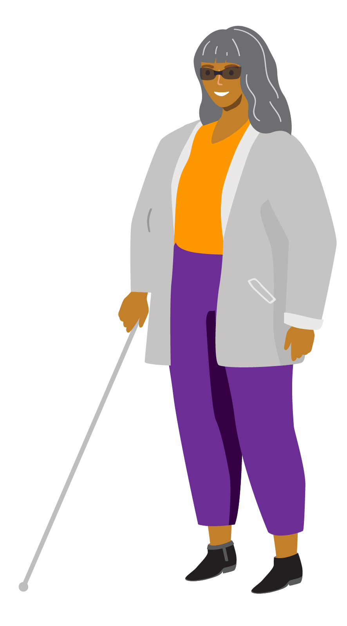
Barriers to Accessing Support Services​
for migrant and refugee women and gender-diverse people with disabilities​
Social isolation​
Financial hardship​
Under-resourced services​
Access to services​
Ableist views​
Immigration system barriers​
Workplace challenges.​
Source: WDV, 2024, 'Barriers to accessing support services for migrant and refugee women, non-binary, and gender-diverse people with disabilities'
Notes:
In 2024, Women with Disabilities Victoria partnered with Multicultural Centre for Women’s Health to develop a series of resources on preventing violence against women and gender diverse people with disabilities from migrant and refugee communities. The outcomes emphasised barriers to migrant and refugee women and gender diverse people accessing disability services and other supports.
Social Isolation: Limited social networks, dependence on caregivers, and community stigma around disability contribute to isolation.​
Financial Hardship: Non-recognition of overseas skills leads to precarious work with little career progression. Some visa categories limit access to social support systems like the Disability Support Pension (DSP) and National Disability Insurance Scheme (NDIS).​
Under-Resourced Services: Services often lack sufficient budget for accessible and culturally appropriate support, including the recruitment of bilingual staff.​
Access to Services: Challenges include limited access to safe, affordable, culturally appropriate healthcare, transport, housing, employment, and sexual and reproductive health information.​
Ableist Views: Assumptions that people with disabilities lack desires can restrict access to sexual and reproductive health resources.​
Immigration System Barriers: Visa status and residency rights restrict access to essential services, creating dependence and fear of reporting violence or discrimination due to potential visa rejection.​
Workplace Challenges: Fear of losing job sponsorship and facing deportation often keeps individuals from disclosing disability to employers or reporting workplace discrimination and harassment.​

Slide 11
Facts on Violence Against LGBTIQA+ People with Disabilities
LGBTIQA+ people with disabilities report significantly higher rates of verbal, physical, and sexual violence compared to people with disabilities who do not identify as LGBTIQA+
Among LGBTIQA+ people with disabilities, trans people with disabilities are more likely to experience physical violence, intimate partner violence, and sexual assault
LGBTIQA+ people with disabilities experience higher rates of poor treatment by health professionals compared to people without disabilities who do not identify as LGBTIQA+
LGBTIQA+ people with disabilities experience the highest rates workplace sexual harassment
Hetero/ cisnormativity, ableism, stigma, and social marginalisation lead to LGBTIQA+ youth with disabilities experiencing greater rates of violence, higher levels of stress, and a reduced sense of safety compared to LGBTIQA youth without disabilities.
Disability services are often not inclusive of LGBTIQA+ people and LGBTIQA+ organisations often do not provide services that are accessible and appropriate for people with disabilities.
Source: WDV, 2026, 'Facts on Violence Against LGBTIQA+ People with Disabilities'
Notes:
WDV is currently co-designing a series of violence prevention resources with LGBTIQA+ people with disabilities. So far, we have published an animation and a factsheet. New resources on supporting LGBTIQA+ people with disabilities will be launched in June.

Slide 12
Essential Actions to Prevent Gender and
Disability-Based Violence
1
2
3
Address the underlying social context that
gives rise to violence against women and girls
with disabilities.
Challenge acceptance of violence against women and girls with disabilities.
Improve attitudes towards women and girls with disabilities by challenging ableist and sexist stereotypes.
4
5
6
Promote the inclusion of women and girls with disabilities in all aspects of life.
Promote women and girls with disabilities’ independence, agency and participation in leadership and decision-making.
Engage men and boys to challenge controlling, dominant and aggressive forms of masculinity.
Source: Our Watch, WDV, 2022, ‘Changing the Landscape: A National Resource to Prevent Violence Against Women and Girls with Disabilities’.
Notes:
How can understanding the drivers and intersectionality guide our response to client disclosures and inform our disability advocacy work?
Changing the Landscape also identifies these 6 essential actions to address the underlying drivers and prevent violence against women and gender diverse people with disabilities? WDV’s Taking Action Guide shares more guidance on how these can be applied:
1. Address the underlying social context that gives rise to violence against women and girls with disabilities.
E.g. Promoting the human rights and social models of disability, when advocating in systems where the medical and charity models of disability are still entrenched.
2. Challenge acceptance of violence against women and girls with disabilities.
E.g. Use a strengths-based approach to talking about disability: use factual language that doesn’t reinforce stereotypes, imply weakness, or suggest disability is a reason for violence. E.g. Women and gender-diverse PWD aren’t “vulnerable” to violence, we are targeted for violence based on our perceived vulnerability.
3. Improve attitudes towards women and girls with disabilities by challenging ableist and sexist stereotypes.
4. Promote the inclusion of women and girls with disabilities in all aspects of life.
5. Promote women and girls with disabilities’ independence, agency and participation in leadership and decision-making.
E.g. Support women and gender diverse people with disabilities to make decisions, and have choices about their own lives, take considered risks and set their own boundaries.
6. Engage men and boys to challenge controlling, dominant and aggressive forms of masculinity.

Slide 13
Thank-you!
​Visit our website and check out our free resources and information at wdv.org.au ​
​
Book a consultation with our Experts by Experience​.
​​​
Book an introductory session on preventing gender- and disability-based violence or tailored training for your organisation​.
​
Contact GandD@wdv.org.au
​

Slide 14
Disability Family Violence Crisis Response Initiative
(DFVCRI)
disability@safesteps.org.au

Slide 15
The Family Violence Protection Act 2008 Victoria
Recognises family violence broadly – includes physical, sexual, emotional, psychological, social and economic abuse, and the impact on children. Prior to this, focus was on physical assaults only.
Centres victim safety and rights – family violence is a human rights violation requiring respectful, survivor‑focused responses.
Strengthens legal protections – expands intervention orders, tailors conditions, excludes perpetrators from the home, and limits victim cross‑examination.
Expands police powers – enables immediate, after‑hours protections and stronger police action to improve safety and accountability.
Multi-Agency Risk Assessment and Management (MARAM) framework - created to allow for easier information sharing, prevent client from having to retell story, coordinate services

Slide 16
Signs that may indicate FV
Withdrawn – The person may be more withdrawn or quieter than usual.
Cancel appointments – The person may cancel appointments more often or with explanations that seem implausible or like they are being forced to (PUVs often withhold or control when support occurs as part of disability based family violence)
Puv present at appointments – PUVs may be consistently present at appointments as a method of intimidation, or a way to ensure a victim survivor does not disclose
Client disclosing feelings of FOG (fear, obligation & guilt)
Unexplained injuries – injuries that seem inconsistent with explanations
Financial abuse/difficulties : Limited money from dsp despite being paid recently. Food insecurity, going without medications.

Slide 17
Responding to disclosures
Be Trauma Informed: prioritise safety, choice, empowerment, avoid re‑traumatisation
Give time and space – Give time and space for people to share their story at their pace. Some disabilities have slower processing speeds, never make someone feel rushed or express impatience
Affirm experiences – Violence is never okay
Active listening - Use open ended questions to elicit information, affirm the experience
Consent for referrals – Offer referrals to local family violence services and respect decisions to accept or decline the referral
Emergency contacts – Establish a safe person
Safety planning/discussions - "If you need to leave quicky" Consider disability needs in safety planning, eg how will mobility aids be transported, what is a safe transport option for the client eg wheelchair taxi
Safe Steps has also created a My Safety plan in Easy English availiable from our website https://safesteps.org.au/resources/
1800 RESPECT have created extensive Easy Read resources on FV: DST Fact Sheet Easy English Booklets
EMERGENCY SUPPORT
Safe Steps 24/7 365 days a year 1800 015 188 000 for police, fire, ambulance
Safe Steps Disability Team

Slide 18
Keeping clients safe in their home
Referrals to FV service – If they consent and if it is safe
Clients are the experts in their own safety – They have managed to keep themselves safe up to the current point in time, be client led
IVO/police and legal – Can be important. Note : IVO may increase risk, unpack with client
Safety planning/discussions - Ring camera doorbell, talking with neighbours, locks on doors and windows, safe word and emergency contact
See: My Safety plan in Easy English available from our website https://safesteps.org.au/resources/

Slide 19
Intersectional services and being culturally responsive
Intouch – Specialist Family Violence Services for culturally and ethnically diverse victim survivors Working With Victim-Survivors - inTouch
Drummond st & Thorne Harbour Health – Specialist Family Violence Services for lgbti + clients WithRespect - queerspace Family Violence | Thorne Harbour Health
Regional FV services & RIAC – Services that support regional victim survivors, RIAC is an advocacy service for people with an intellectual disability Home - RIAC (Rights Information and Advocacy Centre)
Djirra, VACCA – Aboriginal controlled organisations that support victim survivors identify as first nations Djirra - Aboriginal Family Violence Response & Support Service - VACCA
Safe + Equal Disability practice leads – Operating in 9 DFFH regions across VIC out of local FV services Family Violence and Disability Practice Leader Initiative | Safe and Equal
Other intersectional resources Providing tailored and inclusive support | Safe and Equal
Safe Steps Disability Team

Slide 20
Resources and information
Safe + Equal – Peak body for Victoria for specialist family violence services who provide support to victim survivors in Victoria. Also provides modules on disability and family violence and resources https://safeandequal.org.au/resource-library/?_sft_resource_topic=people-with-disability
1800RESPECT – The national counselling service for people experiencing family, domestic, and sexual violence
Safe Steps DFVCRI program – More information on next slide

Slide 21
DFVCRI
SECONDARY CONSULTATION
Available to all professionals working with victim survivors who have a disability
Can not do intake, assessment or direct case management
9am-5pm Monday to Friday
ACCESS TO BROKERAGE
Funding to meet the disability-related needs of people who are experiencing a family violence crisis including complex MH, aging, and chronic health conditions Must be experiencing a FV crisis and be assessed as Serious Risk by a FV service
For example:
Mobility aids
Disability support workers
Accessible transportation
Sensory aids
CAPACITY BUILDING
Presentations in a range of settings https://providers.dffh.vic.gov.au/disability-and-family-violence-crisis-response

Slide 22
Thank you

