Slide 1


Advance Your Advocacy Practice:
Successful grant writing

Slide 2

Acknowledgement of Country
I acknowledge that we are meeting on the land of the Dharawal people, I pay my respects to this land, its people, and to the elders past and present.
I extend this respect to any Aboriginal and/or Torres Strait Islander people present today.
Always was, always will be Aboriginal Land.
PWDA commissioned artwork by Paul Constable Calcott, Wiradjuri Elder and PWDA member.

Slide 3


PWDA
People with Disability Australia (PWDA) is a non-profit, non-government, national cross-disability organisation led by and for Australians with all types of disability. ​
As Australia’s national peak disability rights and advocacy organisation, PWDA has been representing the interests of Australians with disability for over 40 years.
Our education and training focuses on empowering people with disability to take control of their own lives and helps workers in the broader community improve how they work with, provide services for, and support people with disability.​

Slide 4

What we’ll cover
Choosing the right grants
Thinking strategically about funding
Building organisational capacity
Developing partnerships
Embedding co-design
Budgeting for accessibility and inclusion

Slide 5
Why Strategy Matters
Funding should support your goals.
Strong grant opportunities are usually connected to:
Community need
Organisational priorities
Existing expertise
Strategic partnerships
Long-term impact
A grant opportunity may introduce a new idea. The important thing is assessing whether it aligns with your mission, expertise and community needs.

Slide 6
Choosing the Right Grants
Not every grant is worth pursuing.
Before applying, consider:
The time and resources required
Whether the opportunity fits your purpose
Whether your organisation is well placed to deliver
Whether the project creates meaningful impact
What the opportunity might cost you if it pulls focus from other
priorities
Attending information sessions on the opportunity
Saying no to the wrong grant creates space to pursue the
right one.

Slide 7
Assessing Opportunities
Questions to ask before applying:
Area | Key Question
Eligibility | Do we meet the mandatory requirements?
Strategic Fit | Does this align with our purpose and priorities?
Capacity | Do we have the people, systems and expertise?
Community Need | What evidence tells us this is needed?
Co-Design | How will people with disability shape the project?
Partnerships | Who should be involved and why?
Sustainability | What remains after the funding ends?

Slide 8
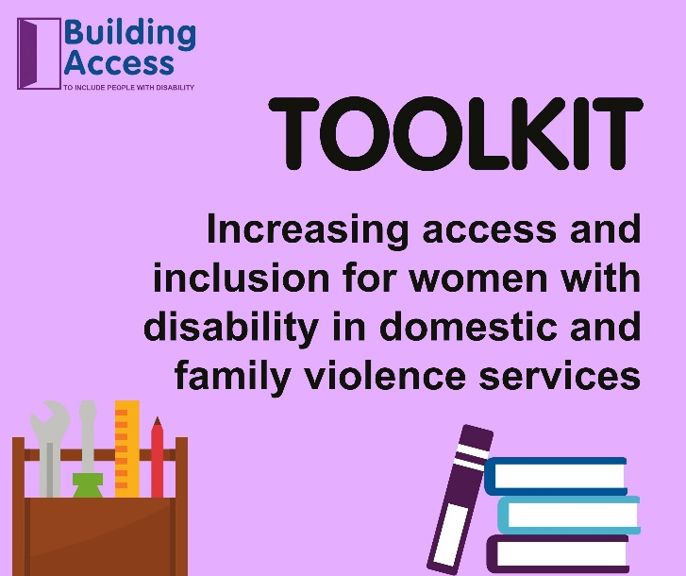
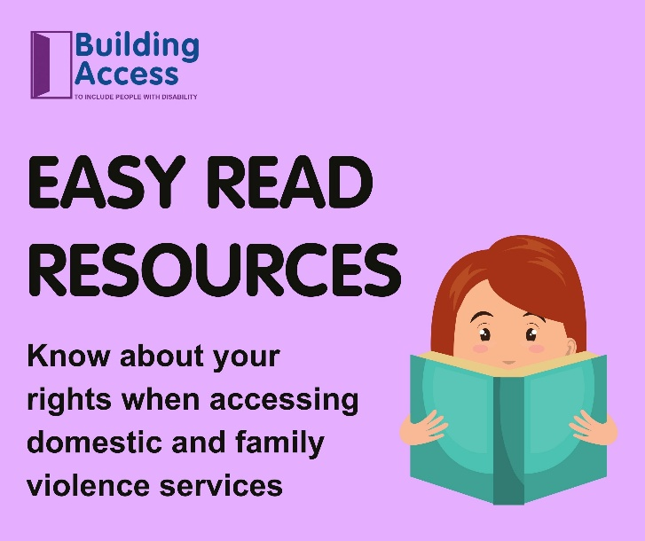
Building Capacity
Grants can help organisations:
Build expertise and capability
Develop resources and tools
Improve systems and processes
Strengthen partnerships
Increase credibility
Create future opportunities

Slide 9
Partnerships
Strong partnerships can:
Share and bring together complementary expertise
Extend community reach
Strengthen credibility
Improve outcomes
Reduce duplication
Increase sustainability
Create opportunities to learn from and support one another
Build stronger sector relationships

Slide 10
Choosing the Right Partners
Do they:
Share similar values and objectives?
Bring expertise we don’t have?
Have trusted relationships with the community?
Strengthen accessibility and inclusion?
Have capacity to contribute meaningfully?
Avoid:
Last-minute partnerships (where you can)
Token involvement
Unclear roles and expectations

Slide 11
Consultation vs Co-Design
Consultation:
We ask for feedback
Co-design:
We design together
People with disability should help shape:
Priorities
Activities
Delivery
Evaluation
Definitions of success

Slide 12
Co-Design in Practice
Examples include:
Advisory groups
Steering committees
Co-design workshops
Paid lived experience roles
Regular feedback and review processes
Good practice:
Pay people for their time and expertise
Build accessibility into all engagement activities
Provide appropriate support and information
Explain how input will influence decisions

Slide 13
Budgeting for Accessibility and Inclusion
Build inclusion into the budget from the start. Consider costs across three areas:
Accessible participation
Interpreting, captioning, Easy Read, transport, support people and accessible venues.
Co-design and lived experience
Payment for time, preparation, facilitation support and accessible engagement.
Inclusive employment
Accessible recruitment, workplace adjustments, assistive
technology and flexible work arrangements
Accessibility isn’t an add-on. It’s part of good project design.

Slide 14

Key Takeaways
Strategic thinking
Clear community need
Strong partnerships
Genuine co-design
Accessibility and inclusion
Long-term impact

Slide 15
Contact us
Information Request Form
Telephone: 1800 422 015
TTY: 1800 422 016
NRS: 1800 555 677
TIS: 13 14 50
Fax: 02 9318 1372
training@pwd.org.au
www.pwd.org.au
https://pwda.smartersoft.io/intakeform

Slide 16
Successful grant writing
17 June 2026

Slide 17
Acknowledgement of Country
The NDRP acknowledges the traditional custodians of Country throughout Australia. The peoples on whose land we live and work, have lived on and cared for Country for thousands of generations, and this land has never been ceded. We pay our respects to them and their cultures, and to Elders past and present.
Notes:
Slide 2
Title: Acknowledgement of Country
The NDRP acknowledges the traditional custodians of Country throughout Australia. The peoples on whose land we live and work, have lived on and cared for Country for thousands of generations, and this land has never been ceded. We pay our respects to them and their cultures, and to Elders past and present.

Slide 18




Who is NDRP?
The National Disability Research Partnership (NDRP) will fund research led by and with people with disability. We will collaborate to share learnings and build the evidence base for successful disability policy and practice.
We exist to build an inclusive national disability research program in Australia.
How we do this:
fund research that is informed by the NDRP Research Agenda
make sure research is done by and with people with disability
strengthen disability research capacity
mobilise evidence for action to influence policy and practice

Slide 19




Our Guiding Principles - the NDRP seeks to:
Advance high-quality research that informs disability policy and practice in Australia
Value the knowledge of people with disability in research
Strengthen disability research capacity
Share research findings widely in useful and accessible ways

Slide 20
What a strong application looks like
Assemble a team
Respond to the criteria
True co-design
Partner organisation(s)
Research Team Members
Contact Person
Administrating Organisation
1. Relevance to the topic and potential for policy and system impact (20% weighting)
2. Research quality and methodology (30% weighting)
3. Leadership and inclusion of people with disability (25% weighting)
4. Capacity and resources to deliver the project (15% weighting)
5. Risk management and value for money (10% weighting)
Mutuality
Shared power
Fair resources

Slide 21
What assessors look for
Is there a genuine need?
Is the proposal clear and easy to understand?
Are the right people involved and are partnerships genuine?
Can the project realistically be delivered?
Will it make a meaningful difference?

Slide 22
NDRP Resources
NDRP Guiding Principles & Research Agenda
NDRP resources and videos
Subscribe to the newsletter
APO Disability Research Collection
Advocacy 101 - good partnerships
Co-design of research 101 – from the start
What is co-design?
Co-Design in Action
How to Build a Co-Design Team
Co-Design in Your Application
Partnership resource pack
Co-design partnerships: a mutual exchange
Planning for Purposeful Co-design
Advocacy 101 - good partnerships
Co-design of research 101 – from the start
Evidence mobilisation - easier to find, easier to share
How to impact policy 101 – disability research and policy and practice
Policy makers and practice professionals
Safety of people with disability - NDRP Research Agenda topic
Elimination of restrictive practices - NDRP Research Agenda topic
Accessible and inclusive communities - NDRP Research Agenda topic
Let’s talk about disability data

Slide 23




How to engage with the NDRP
Email: info@ndrp.org.au
Phone: 03 9000 3813 SMS only number: 0485 931 168
Subscribe to our newsletter at www.ndrp.org.au for updates
Follow us on Facebook and LinkedIn
Notes:
Slide 12
Title: How to engage with the NDRP
Decorative icons and text reads:
Email: info@ndrp.org.au
Phone: 03 9000 3813
SMS only number: 0485 931 168
Subscribe to our newsletter at www.ndrp.org.au for updates
Follow us on Facebook and LinkedIn
END

